Slide 1

Trash detection & quantity estimation
Tommaso Mattei 1884019
Federico Ziegler 1808702
Mattia de Luca 1883820
Academic Year 2025/26

Slide 2


Abstract
Introduction
Referenced paper
Project work
Conclusion

Slide 3
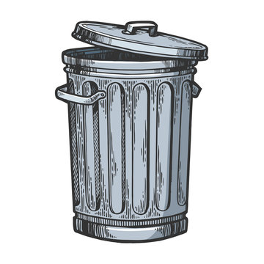
Introduction ●○
Why is trash detection important?
Increasing population, rapid urbanization, and changing consumption patterns have led to a surge in waste generation
The increase in urban and industrial waste makes traditional management inefficient
Detecting waste is a complex task: waste varies in shape, material and size

Slide 4

Introduction ○●
A potential use case
Estimating bin fill levels using computer vision to plan emptying: no longer based on a fixed schedule
Recognition of waste type (plastic, organic, unsorted) that can improve recognition of sorting errors
Detection of overloaded bins to prevent waste accumulation, urban decay and health risks in resource scarce environments

Slide 5
Abstract
Introduction
Referenced paper
Project work
Conclusion

Slide 6
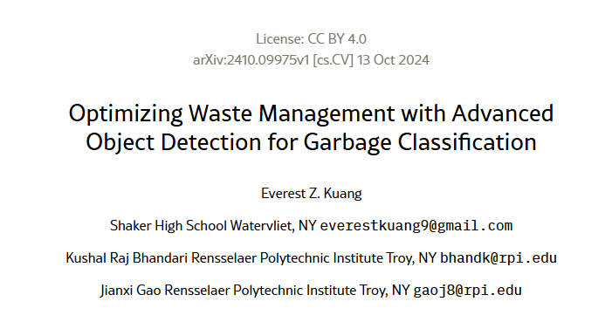
Referenced paper ●○○○○○
Referenced paper
The original idea of the paper was to review the performance of the YOLOv5s model on a real life waste test set

Slide 7

Referenced paper ○●○○○○
What is YOLO?
You Only Look Once: popular object detection and image segmentation CNN
A single neural network analyzes the entire image in a single pass.
The image is divided into a grid of cells. Each cell predicts the bounding box, confidence and class of the object.

Slide 8
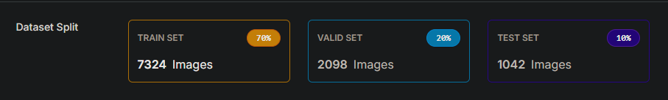
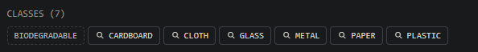

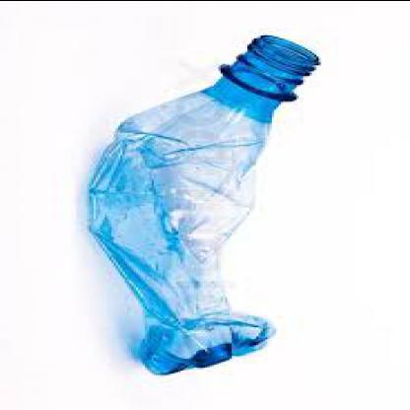
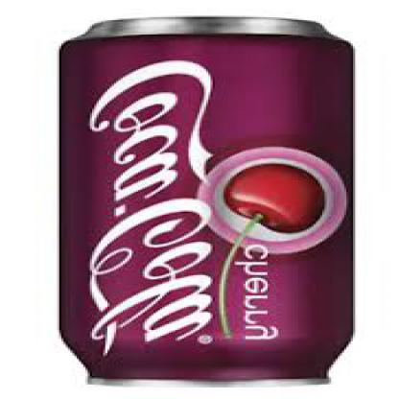
Referenced paper ○○●○○○
Dataset for Yolo5

Slide 9
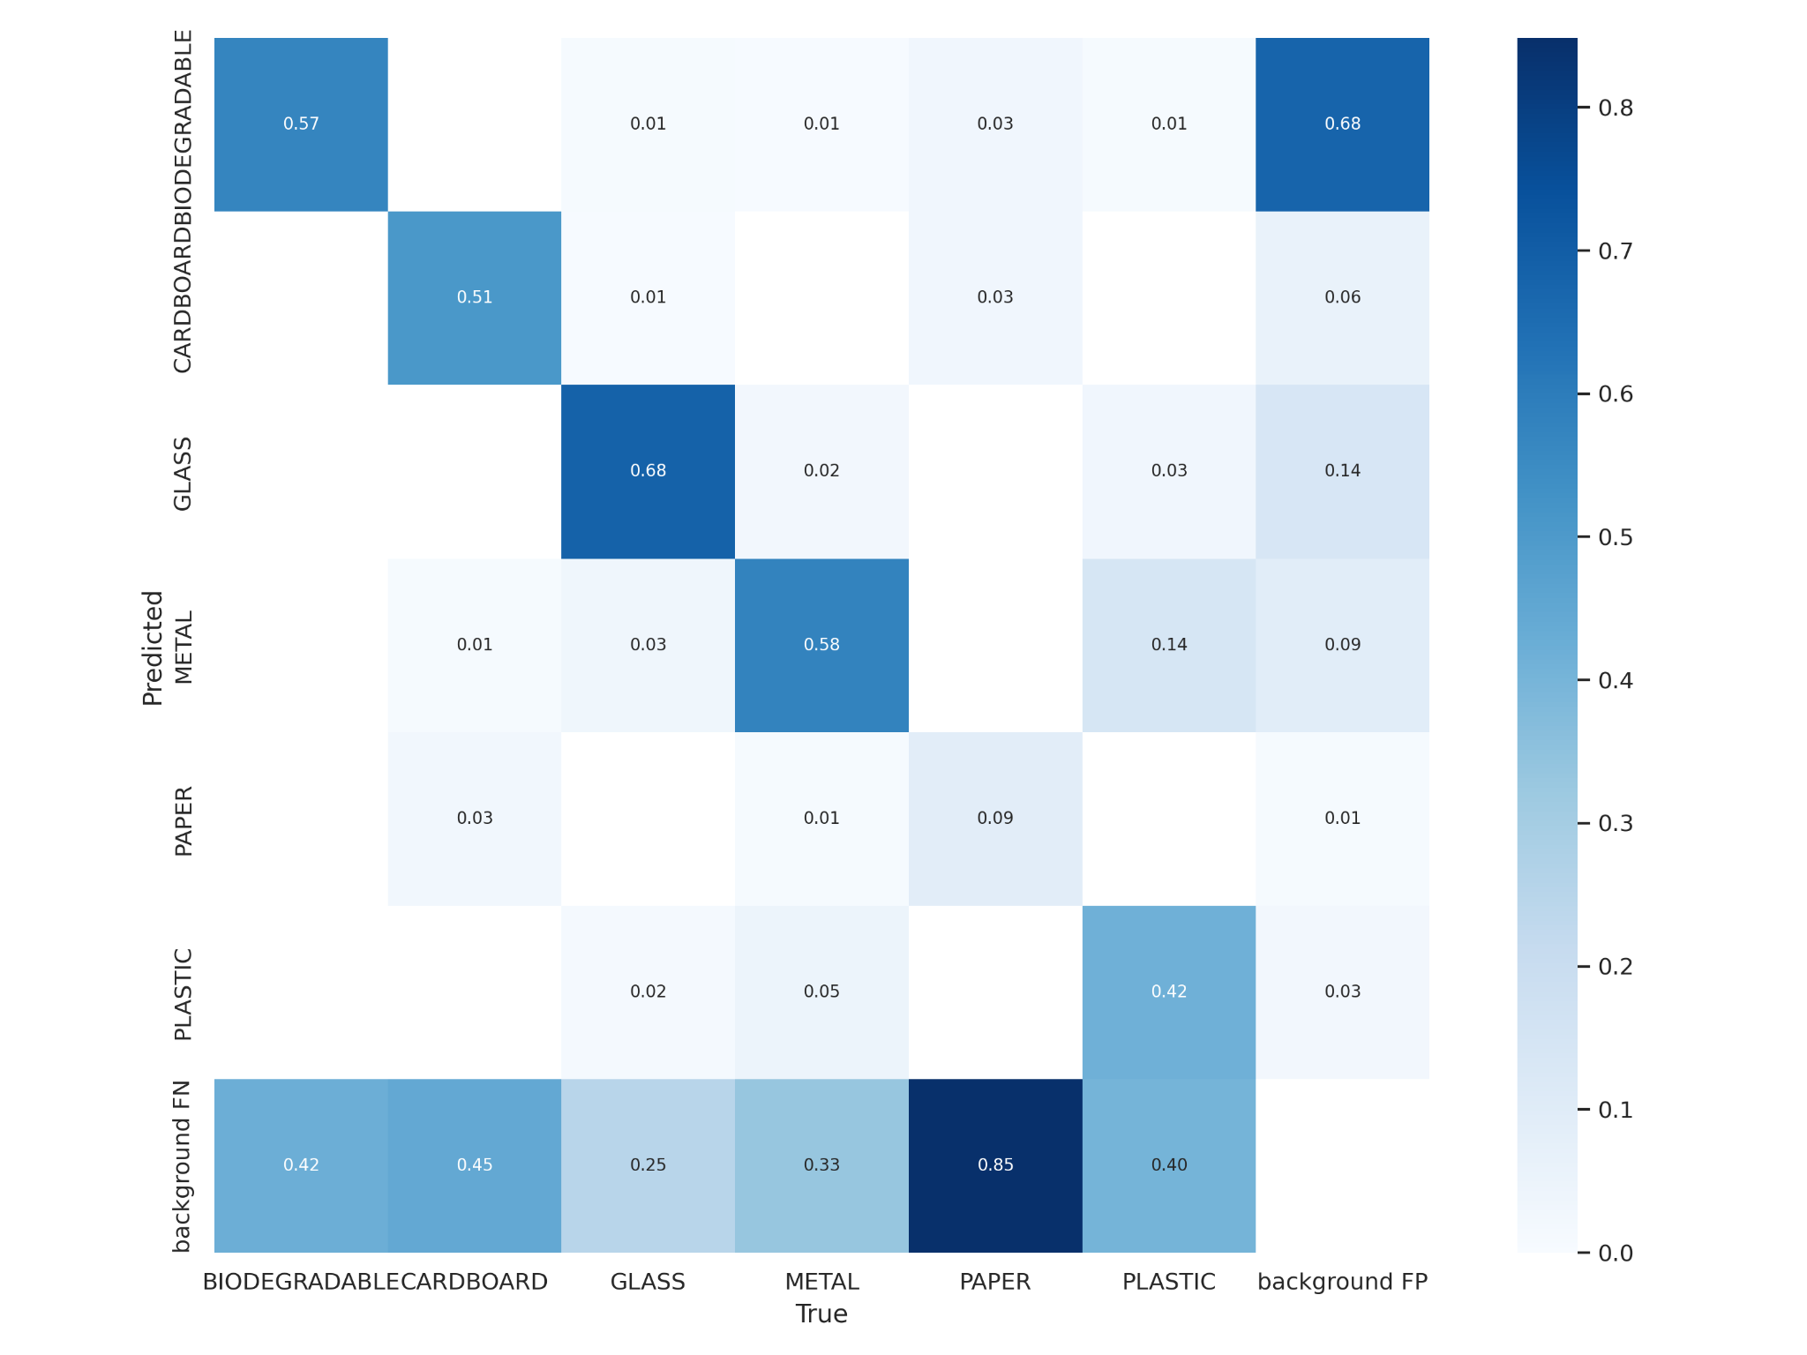
Referenced paper ○○○●○○
Yolo performance

Slide 10
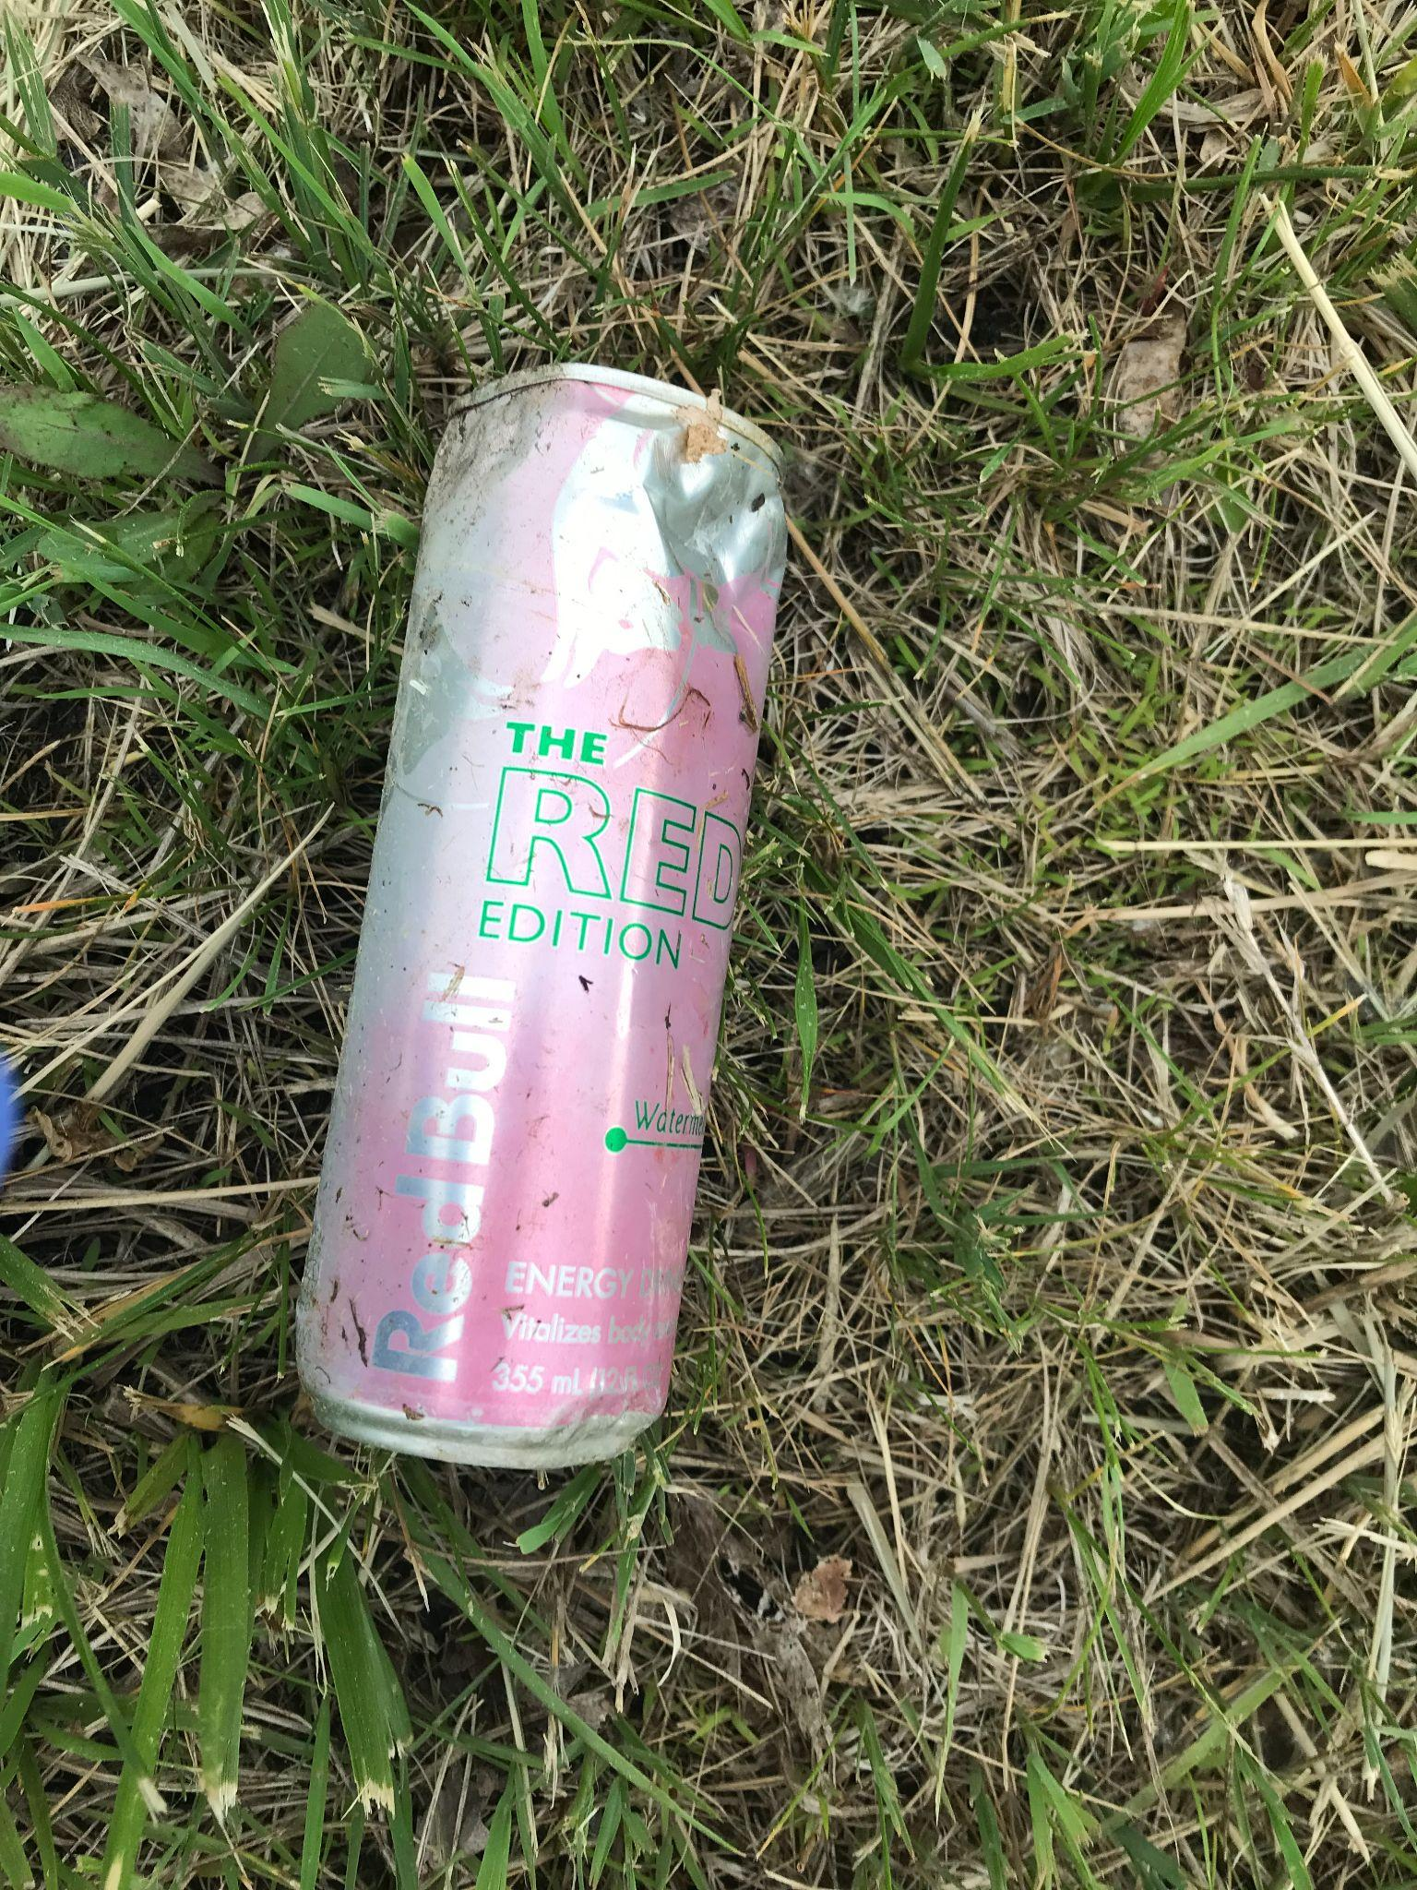
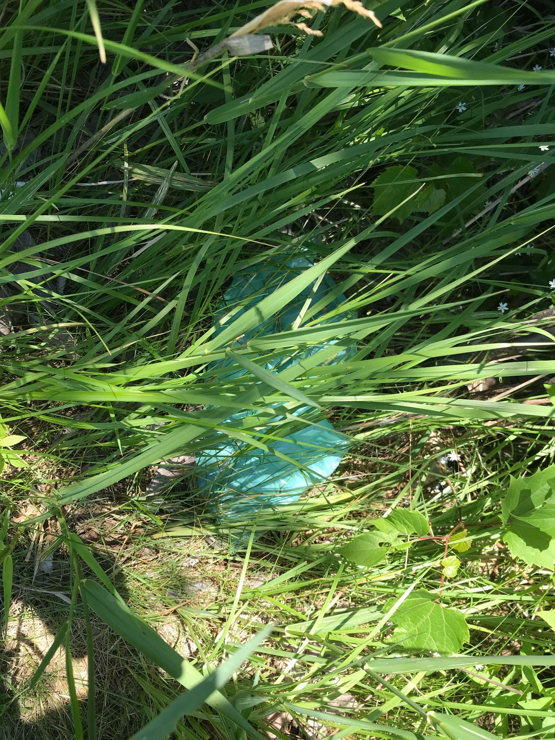
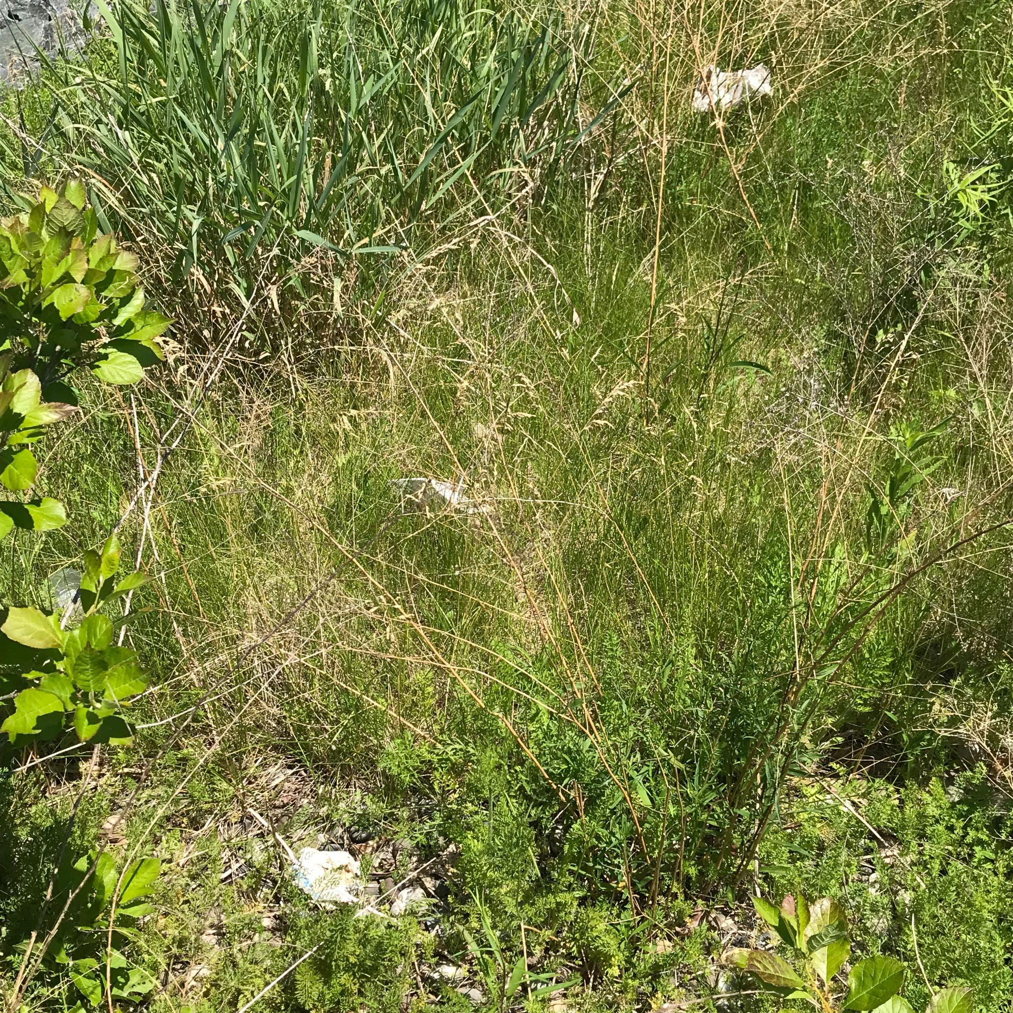
Referenced paper ○○○○●○
Real life waste test set
The test set is composed of 118 real life waste images

Slide 11
Referenced paper ○○○○○●
Final tests & TPR metric
The original paper did not have an explicit metric for performance
We empirically calculated one by observing their results on the test set
TPR
Avg extra objects
0.20
1.62
Notes:
Avg extra objects = si riferisce al caso di successfull identification soltanto

Slide 12
Abstract
Introduction
Referenced paper
Project work
Conclusion

Slide 13
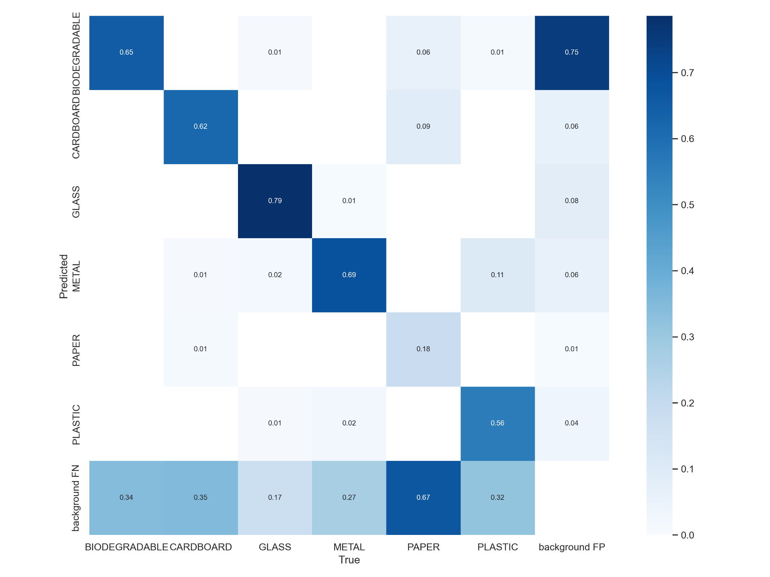
Project work ●○○○○○○○○○○
First experiment: yolov5s

Slide 14
Project work ○●○○○○○○○○○
First experiment: yolov5s results
TPR
Avg extra objects
0.48
0.61

Slide 15
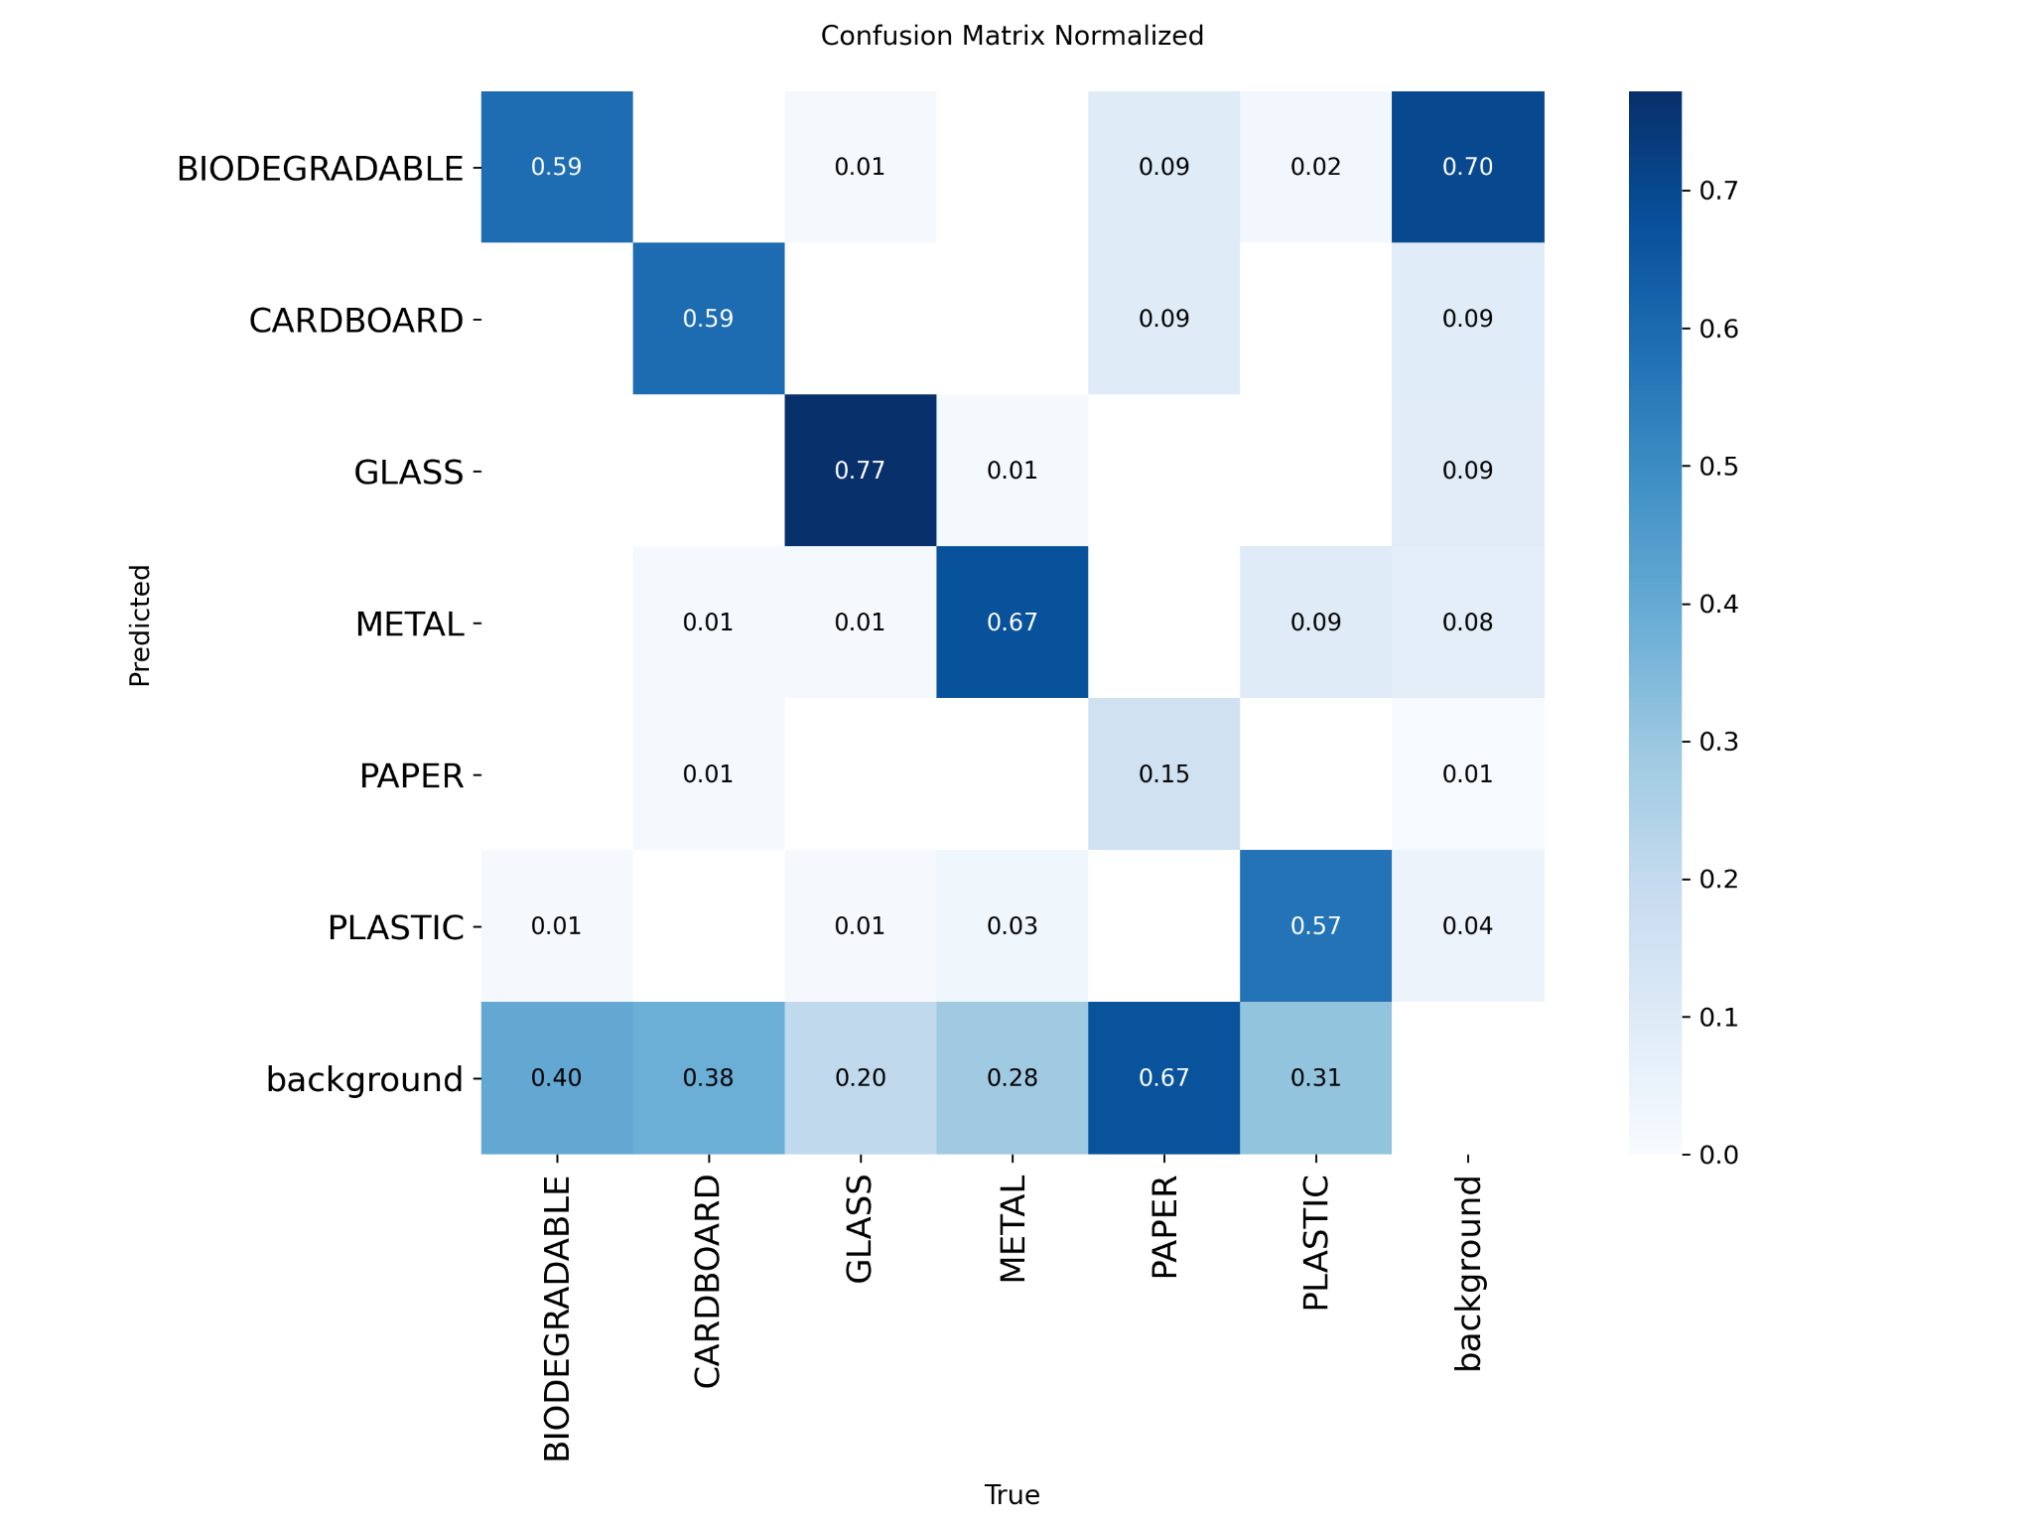
Project work ○○●○○○○○○○○
Second experiment: yolov11s

Slide 16
Project work ○○○●○○○○○○○
Second experiment: yolov11s results
TPR
Avg extra objects
0.39
0.46

Slide 17
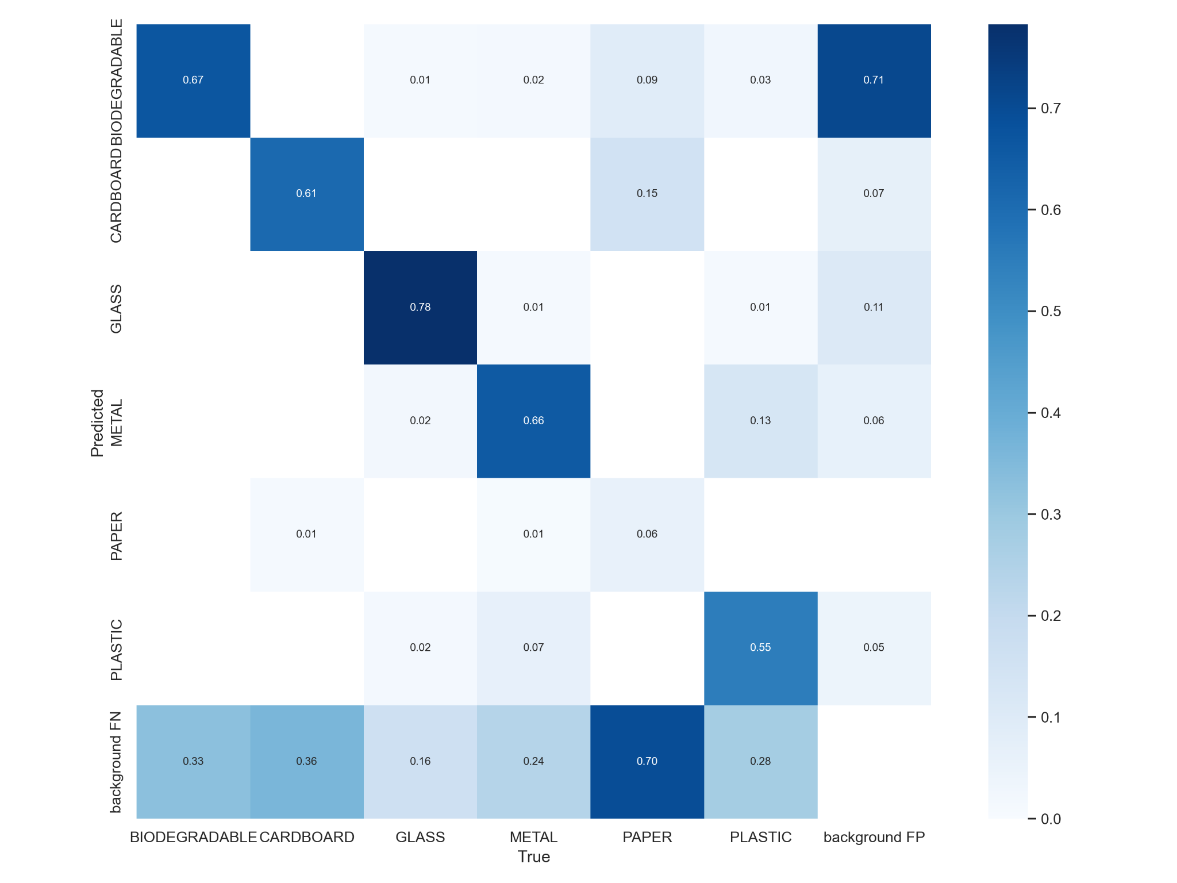
Project work ○○○○●○○○○○○
Third experiment: yolov5m

Slide 18
Project work ○○○○○●○○○○○
Third experiment: yolov5m results
TPR
Avg extra objects
0.45
1.09

Slide 19
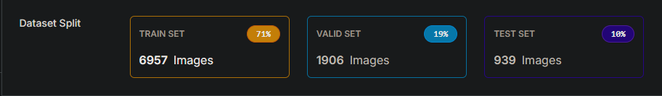
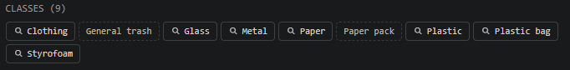
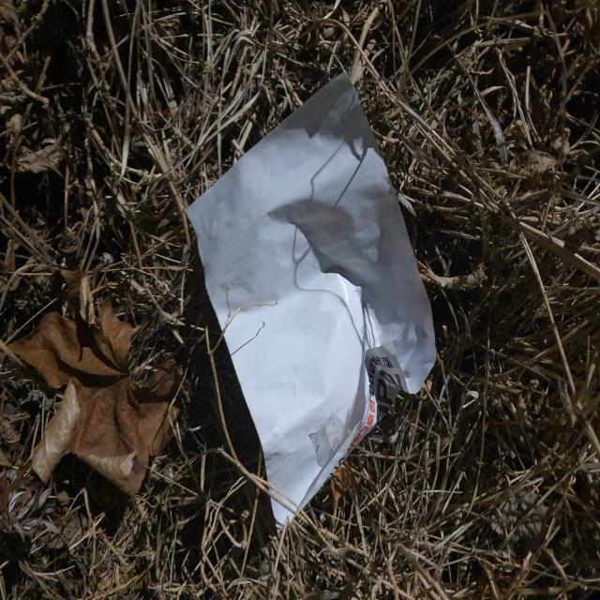
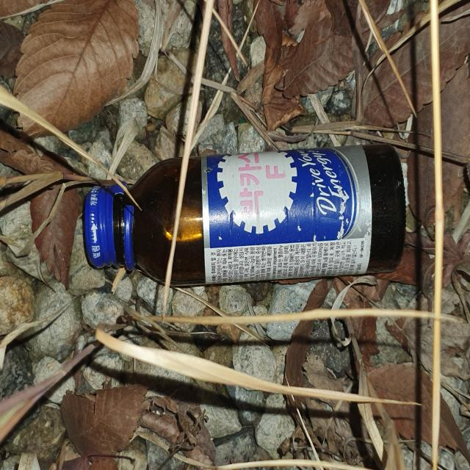
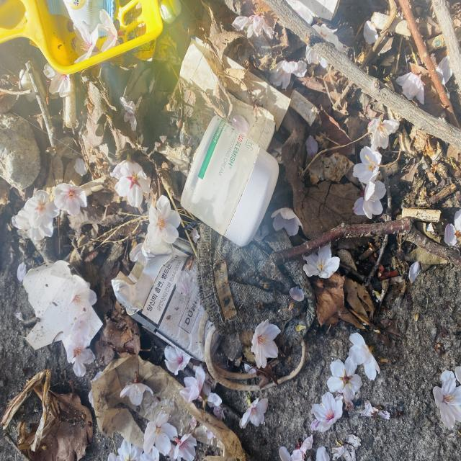
Project work ○○○○○○●○○○○
New dataset for training

Slide 20
Project work ○○○○○○○●○○○
Fourth experiment: new yolov5s results
TPR
Avg extra objects
0.45
0.28

Slide 21
Project work ○○○○○○○○●○○
Fifth experiment: new yolov11s results
TPR
Avg extra objects
0.39
0.23

Slide 22
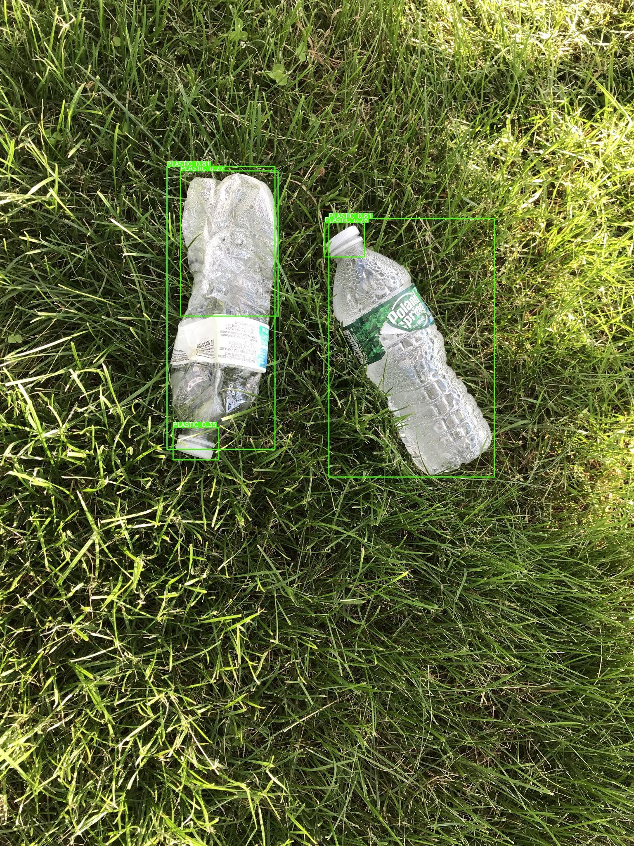
Project work ○○○○○○○○○●○
Quantity estimation
We then implemented a python script to compute the percentage of the area covered by detected waste.
This can be found in the computeArea.py file.

Slide 23
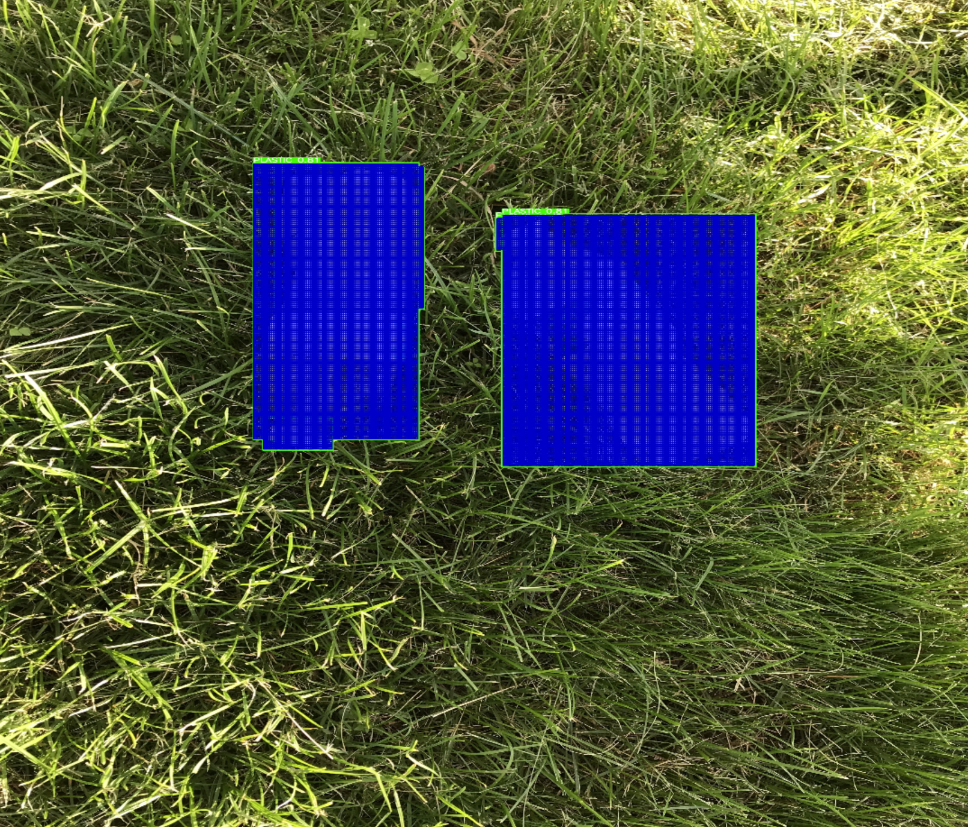
Project work ○○○○○○○○○○●
Quantity estimation
The script allow for a ranking of all evaluated images by cover and can be used alongside external data such as the camera distance for volume estimation

Slide 24
Abstract
Introduction
Referenced paper
Project work
Conclusion

Slide 25

Conclusion ●○
Thoughts on performance
Yolo 5 offers faster inference taking an average of 15.2 ms against YOLO 11’s 34 ms
To determine the best model and dataset combination for the use case metrics like tpr, number of erroneous classifications and inference speed must be taken into account

Slide 26
Conclusion ○●
Future endeavors
Using a dataset with more and more appropriate classes/labels that better reflect real life waste management
Extensively search for the best model versions and hyperparameters
Implementing a more complex volume estimation protocol based on available information such as camera position

Slide 27
Trash detection and quantity estimation
Thank you for the attention!

